Slide 1
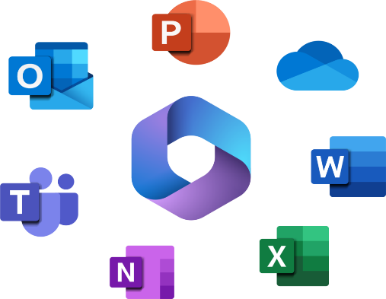

Computer Components System
Chapter 2

Slide 2
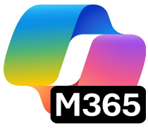
LEARNING OUTCOMES
By the end of this session, students should be able to;
  Central Processing Unit (CPU)
  Memory and Storage
  Input Devices
  Output Devices
  Communication and peripheral devices
  Users

Slide 3
INTRODUCTION
A computer won’t function without components. It is essential for the internal and peripheral components to be present to be fully functional.

Slide 4
1.Central Processing Unit (CPU)
CPU is normally referred as brain of the computer. It executes millions of instructions per seconds.
Input devices like mouse or keyboard is initially used to enter data. Then the CPU will perform the four (4) mains tasks:
Receives (fetch) instructions from the memory and it makes sure the address matches the corresponding instructions and forwards the request to RAM. CPU and RAM both works together.
Translate (decode) instructions into a form the CPU can simply understand, which is machine language (binary).
Executing and carrying out given instructions.
Storing the outcome of the execution back to memory for later use.
Finally, the output is the one that comes out from the printer. The above process is called fetch-decode-execute cycle.

Slide 5
Three (3) main Components of the CPU
CPU receives data and commands from a user and process it according to the instructions. The CPU has three main components:
Memory Unit
Once a user enters data using input devices, the computer system stores this data in into memory unit. This data will now remain here until other components of CPU process it. The memory unit uses a set of pre-programmed instructions to further transmit this data to other parts of the CPU.
Arithmetic Logical Unit (ALU)
It performs arithmetic calculations like addition, subtraction, division, multiplication, and logical operations, etc.
Control unit.
It controls the entire operations of the computer system. It Acts as a traffic. It receives data from input devices and sends it to processing units and finally transmits processed data to output devices for users.

Slide 6
Inside the CPU
At the hardware level, a CPU is an integrated circuit, also known as a chip. An integrated circuit "integrates" millions or billions of tiny electrical parts, arranging them into circuits and fitting them all into a compact box as shown in Fig 2.1.
An Intel 80486DX2 CPU chip.
Figure 2.1 shows an Intel chip, covered in gold and wires.

Slide 7
2.Memory
When input devices send binary data to a CPU, it immediately stores that data in memory to make it easier to process.
Let's say we ask a computer to add 2 + 4. Here's what it will do:
Store 2 (0010001000100010) and 4 (0100010001000100) in memory
Use a circuit in the CPU to calculate the result
Store 6 (0110011001100110) in memory
Since the CPU is constantly using data from memory, they're connected via a memory bus, a high-speed communication transfer system, typically made from wires, conductors, or optical fibers as show below in Fig 2.2.

Slide 8
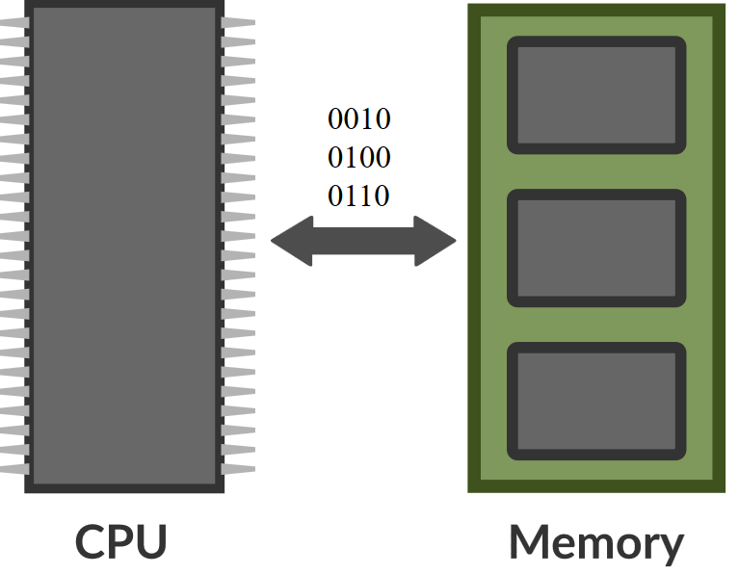
Memory is designed for fast access and typically stores only the data and instructions that are necessary for the currently running programs on a computer.
Computer memory has size limitation. Computers also vary a lot in memory size, usually because of physical size constraints. A desktop computer has more memory size than your phone. RAM differs in sizes, for example, 4GB, 8GB, 16GB, etc... Users with 2GB or less can consider upgrading to improve performance and functionality. There are different reasons why computer slows down and some of them for upgrading Memory size is to improve computer performance, accommodate extra programs, faster internet browsing, enhanced network capability in working environment, for example, shared resources like printer with upgrade in RAM allow users to print heavy graphics without any issues of slowdown with the network.
Figure 2.2 showing the flow of data between CPU and Memory

Slide 9
Memory Types
There are basically two types of computer memory. Internal and External memory. Internally memory has two types.
1. RAM (Random Access Memory)
It is Volatile memory – it loses data when computer power is off.
It Stores data temporary as long as the power is on.
It is a Primary Memory of the computer.
The speed of the computer depends on the RAM size.
For example, 4GB, 8GB, 16GB, etc.

Slide 10
Data and instructions are stored as BITS (binary digits). Everything that is entered into a computer is translated into a computer recognizable format called binary (zeros or ones, 0s or 1s).
Kilo =1,000 (KB) thousand
Mega = 1,000,000 (MB) Million
Giga = 1,000,000,000 (GB) Billion
RAM is measured in “bits”.
8 bits is equal to 1 byte.
A kilobyte is equal to 1024 bits and a megabyte equals to 1024 kilobytes. 0

Slide 11
2. ROM (Read-Only-Memory)
It is a non-volatile memory. It will not lose data even when computer power is off.
Data is stored permanently. User cannot edit or alter the content but can ready the content only.
For example, it is used in the startup of the computer during bootup process.
Information and instructions stored in ROM are in binary format.
Computers store data permanently in different type of memory: external memory or secondary storage, like a hard drive or USB drive.
Secondary Memory
Computers store data permanently for later retrieval in secondary memory. Secondary memory, also known as auxiliary storage or external memory are needed for users to store data. Some examples of secondary memory are hard disks, har drives, USB/Flash drives, CDs, DVDs, magnetic tapes, SD cards, etc.

Slide 12
Secondary Memory
Computers store data permanently for later retrieval in secondary memory. Secondary memory, also known as auxiliary storage or external memory are needed for users to store data. Some examples of secondary memory are hard disks, har drives, USB/Flash drives, CDs, DVDs, magnetic tapes, SD cards, etc.

Slide 13
Storage Types
Personal computers come with a hard drive, a permanently attached secondary storage. Many computers have input ports for USB drives or SD cards, forms of portable secondary storage. That allows us to store lots on our computers, but also to easily transfer from one computer to another.
Secondary storage devices can be implemented using a variety of electronic technologies, like flash memory, optical discs, and magnetic disks.
Storage speed
All secondary storage acts the same way. The CPU can write data into storage and it can read data from storage.
To the user, what matters is the speed of those read/write operations. Flash memory is faster than its predecessors, so most new computers come with that.

Slide 14
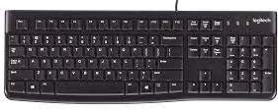
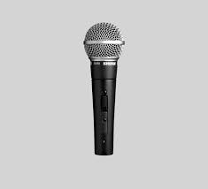
3.Input Devices
Devices that we feed computer with information. Some common examples of input devices are: keyboard, it is used to enter data into computer and it is displayed as an output on the screen
Microphones are used to capture sound waves and converts them into audio signals. The audio signals are converted into digital data and stored in the computer and we hear the sound from an output device such as speaker.
Microphone is an input device to input sound that is then stored in a digital form.

Slide 15
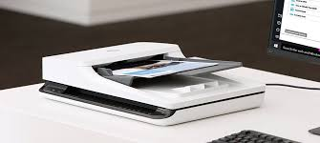
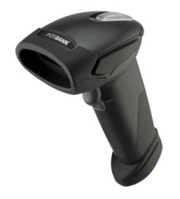
Scanners are used to capture image data, and virtual reality devices to capture our body movements.
Scanner is used an input device.
For example, handheld scanner is a small manual scanning device which is held by hand and is rolled over a flat image that is to be scanned. One of the commonly used handheld scanners is the barcode scanner which you would have seen in shopping stores.

Slide 16
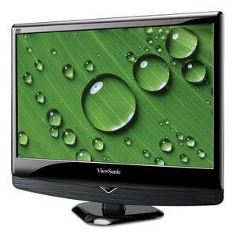
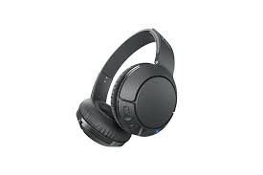
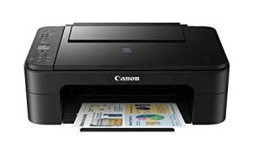
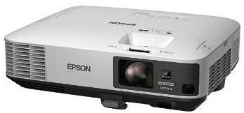
4.Output Devices
Devices that display the output as a result of using input devices to capture data or an image. Examples of output devices are: monitor, which displays text, images.
Headphones display output sound. It allows you to listen to audio or watch movies from computing devices.
Printers’ output ink on paper. A printer produces hard copies of the processed data. It enables the user, to print images, text or any other information onto the paper and projectors output light. A projector is an output device that enables the user to project the output onto a large surface such as a big screen or wall by connecting to a computer to project their output onto a screen. It uses light and lenses to produce magnified texts, images, and videos. So, it is an ideal output device to give presentations in meeting or in a lecture to students.
Some other examples of output devices include: speaker, video card, sound card, etc.

Slide 17
5.Software
Software is a set of programs or sequence of instructions that allows the users to perform well-defined function or some specific tasks to achieve results.
Types of software are;
System
Application

Slide 18
System Software
System software is a computer program that helps the user to run computer hardware or software and manages the interaction between hardware and software. These software programs are designed to run on a computer's application programs and hardware and coordinates the activities and factions. In addition, it controls the entire operations of the computer hardware and provides an environment or platform for all the other types of software to work in. The OS is the best example of system software; it manages all the other computer programs like office applications. Other examples of system software include the firmware and system utilities.

Slide 19
Operating System (OS)
The operating system is the most prominent example of system software that acts as an interface between the user and system hardware. It is a group of software that handles the execution of programs and offers general services for the application that runs over the computer. There are various types of operating systems available in the market, such as embedded operating systems, real-time OS, distributed OS, single or multi-user operating system, mobile, Internet, and various others.

Slide 20
Different types of Operating Systems (OS)
Some of the commonly used examples of operating systems are given below.
Windows 95, XP, 7, 8, 10, and 11
Apple's iOS
Apple's MacOS
Android
CentOS
Linus
Ubuntu
Unix

Slide 21
Drivers Software
Also known as device drivers, this software is often considered a type of system software. These device drivers control the devices and peripherals connected to a computer, enabling them to perform their specific tasks. Every device that is connected to a computer needs at least one device driver to function. Examples include software that comes with any nonstandard hardware, including special game controllers, as well as the software that enables standard hardware, such as USB storage devices, keyboards, headphones and printers. If the drivers are not configured correctly, you may not hear sound from your PC or you may not be able to print your document.
Some common examples of such device drivers that connect hardware devices (printers, sound cards, network cards, hard disks, floppy disk, keyboard, mouse, etc.) to a system easily are as follows:
BIOS (Basic Input/output System) Device Driver
USB (Universal Serial Bus) Drivers
Motherboard Drivers
Display Drivers
Printer Drivers
Sound Card Driver
ROM (Read-only memory) Drivers
VGA (Video Graphic Array) Drivers

Slide 22
Application Software
The most common type of software, application software is a computer software package that performs a specific function for a user. Application software are designed for specific tasks. They cannot operate without the absence of operating systems. There are many different types of application software out there in the market. An application can be self-contained, or it can be a group of programs that run the application for the user. Examples are different versions of office applications include office suites, graphics software, databases and database management programs, web browsers, word processors, software development tools, and image editors.
These are desktop applications installed on user’s PC and use the computer memory to carry out specific tasks. They are taken up space from computer hard drive and do not need the internet connection to work, however, they may require some hardware devices as part of the requirements in order to run.

Slide 23
Other Software
Other System software apart from System and Application Software are as follows;
Programming Software-examples, Microsoft Visual Basic Studio 6.0
Middleware –software glue that connects different software applications or components
Embedded Software-Specialized software for controlling machines and devices not typically considered computers.
Networking & Security Software- Manages, secures, and monitors network communications.
Artificial Intelligence & Data Science Software-tools for intelligence systems, machine learning and data analysis
Database Software (Database Management System-DBMS)-Manages data storage, retrieval and organization
Stimulation & Scientific Computing Software – models real world systems and performs complex computation
Cloud & Distributed System Software-enables cloud computing and distributed computing paradigms.

Slide 24
6. Users
The users are considered to be an important component of computer system. Users play important role in ensuring the other components are up and running.
The users can be classified into the following categories.
IT Manager – person who works closely with CEO and execute tasks on a managerial level. Involves in policies, planning, project management and ensure all hardware peripherals to softwares are up and running smoothly.
Programmer – person who is responsible to write codes for computer programs
IT Administrator – ensure daily operations are routinely checked and runs smoothly.
Users (employees) – people who use computer daily for data entry, processing, etc.

Slide 25
Summary
The main components of computer are:
Central Processing Unit (CPU) is the brain of the computer.
  Main components of CPU
    Memory Unit stores data for use on temporary basis for as long as the power is on.
    Arithmetic Logical Unit (ALU) performs all the calculation.
    Control Unit has direct control over the entire computer system.
Memory is the storage area of computer where information is stored for immediate use. Memory is used by operating system to store hardware and software. It comes in different sizes.

Slide 26
Two types of computer memory.
  Primary memory, for example, Random Access memory (RAM).
  Secondary memory, for example, Hard disk.
Input devices – devices that feed computer with information, for example, mouse.
Output devices – devices that display the result, for example, Monitor.
Software is a set of programs or sequence of instructions that allows the users to perform well-defined function or some specific tasks to achieve results.
  Types of Software:
  System Software
    Operating System, example: Windows 10 & 11
    Device Driver, example, Printer driver
    Utility Software, examples, anti-virus & disk cleanup
    Firmware software, examples, BIOS/UEFI & embedded system controllers
    Application Software
    Productivity Software, example, MS Office Suite.

Slide 27
Users
  IT Manager – person who works closely with CEO and execute tasks on a managerial level. Involves in policies, planning, project management and ensure all hardware peripherals to softwares are up and running smoothly.
  Programmer – person who is responsible to write codes for computer programs
  IT Administrator – ensure daily operations are routinely checked and runs smoothly.
  Users (employees) – people who use computer daily for data entry, processing, etc.

Slide 28
Review Activities:
Based on the Lecture covered, name the components that make up computer system.
What is the “brain” of the computer called?
Name and explain the three main parts of Central Processing Unit (ALU).
Name two (2) internal types of memory.
Provide three (3) characteristics each for two (2) internal types of memory in Question 4.
Explain Input device and give three examples.
Explain Output device and give three examples.
Explain software.
Provide explanation for System Software and give an example.
What is the difference between operating system and application software?
Provide two (2) examples each.

Slide 29
Thank you !!

